Slide 1
Yorkshire Cancer Community
A Cancer SMART Presentation

Slide 2

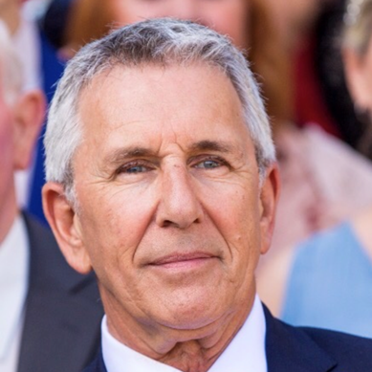
Yorkshire Cancer
Community
Registered charity 1185838
Network of patients, carers, professionals
Access to patient experience, feedback, intelligence, to shape services and respond
to ‘live’ issues
Partnership to deliver Cancer SMART
Improve screening uptake
Prevention of cancer
Encourage healthy lifestyles
YCC Chairman Dr Stewart Manning

Slide 3

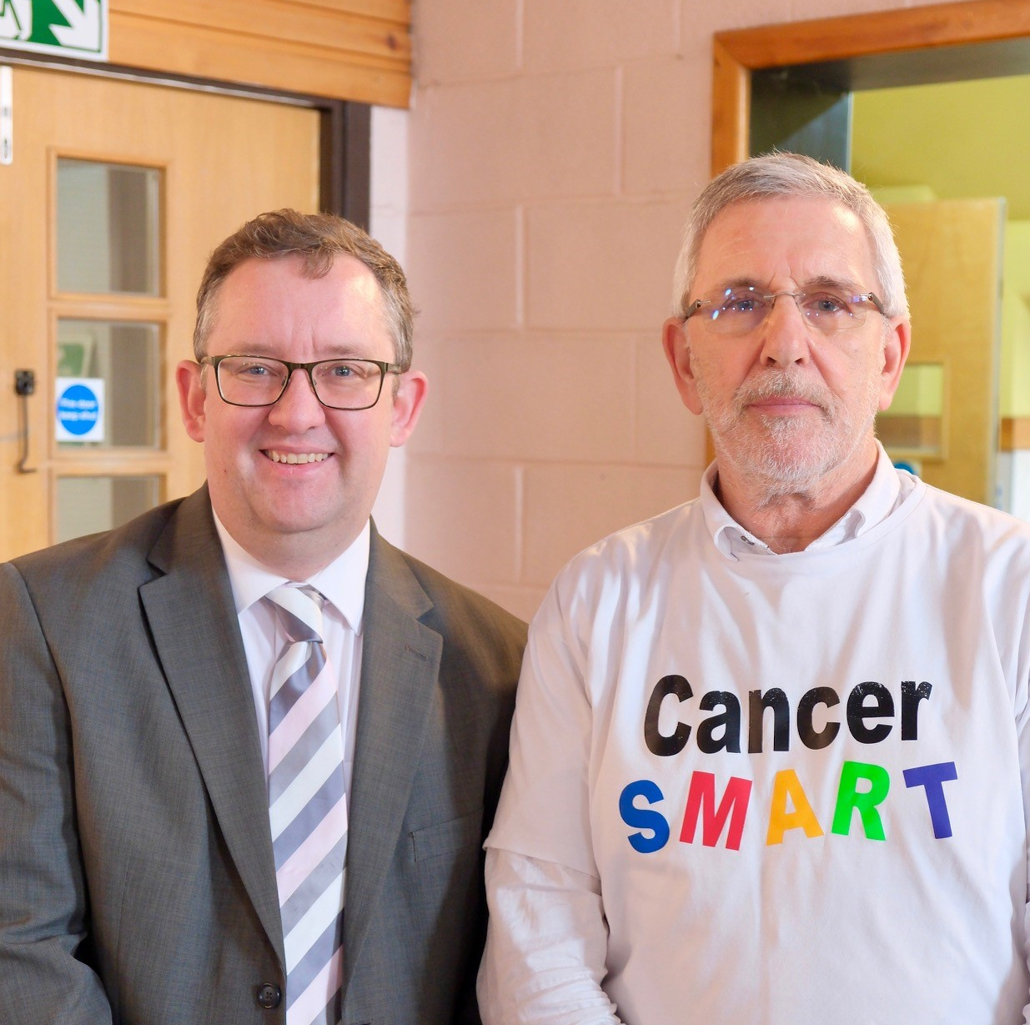
What is the
Cancer Alliance?
21 Cancer Alliances nationwide
Funding from (and accountable to) NHS England
Bringing local partners together to transform outcomes for people affected by cancer.
We believe that the best way to achieve our ambitions is to transform services so that cancer care, treatment and support is wrapped around each individual patient throughout their entire cancer journey.
From Left to Right:
WY&HCA managing director Jason Pawluk
and YCC Chairman Dr Stewart Manning

Slide 4
West Yorkshire & Harrogate
Cancer facts
Every week in West Yorkshire
225 people are diagnosed with cancer
108 people will lose their lives because of cancer
Yorkshire is one of the regions hardest hit by cancer
Every 17 minutes, someone in Yorkshire is told they have cancer
Over 31,000 people in Yorkshire are diagnosed with cancer each year, this is more than in many other parts of England
In Yorkshire, 1 in 2 cancers are diagnosed at a late stage, when it’s often harder to treat
Link to YCR website here

Slide 5

West Yorkshire & Harrogate
Cancer facts – continued
Five factors that impact cancer in Yorkshire
Yorkshire’s large and diverse geography
Late-stage cancer diagnosis
Low uptake of screening programmes
Yorkshire has the highest smoking rates in England
Less funding for cancer research in Yorkshire
Link to YRC website here
Image credit: World Obesity Federation
Some groups tend to have worse cancer outcomes
People living in more deprived communities
‘BAME’ (Black, Asian, and Minority Ethnic) groups
People living with mental illness, physical disabilities or learning disabilities
Trans and gender diverse people
Link to Macmillan health inequalities report here

Slide 6
The Cancer SMART message is
Screening saves lives by prevention and early detection
Making cancer an everyday conversation
Awareness of unusual and persistent changes
Reduce risk with a healthy active lifestyle
Take action NOW against cancer

Slide 7
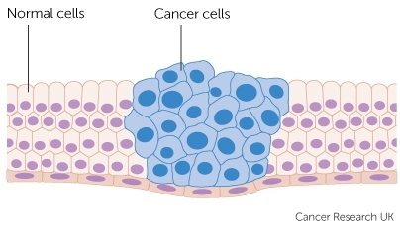
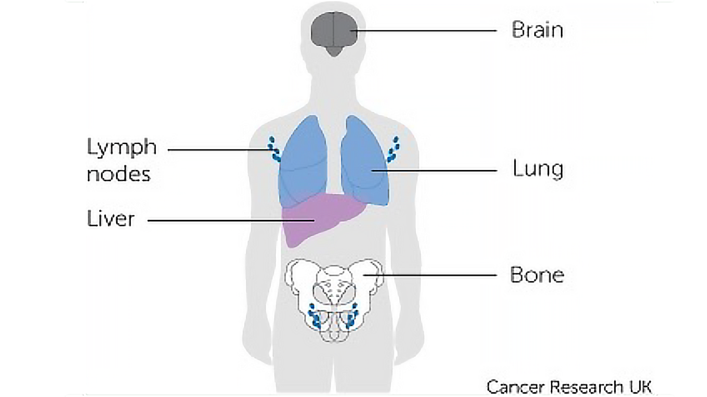
What is cancer?
1 in 2 people will develop cancer in their lifetime
Cancer occurs when our body’s cells become abnormal and multiply out of control.
Usually, they form a lump of tissue “tumour”. This is known as primary cancer.
These abnormal cells can spread, forming lumps in other parts of the body which is known as secondary/metastasis cancer.
Symptoms depend on the type of abnormal cell, and where in the body the cancer is.
Link to CRUK report here
Image credit: Cancer Research UK

Slide 8
Screening saves lives by prevention and early detection
Question:
How many cancer screening programmes are there
in the UK?
One
Two
Three
More than three

Slide 9
Screening saves lives by prevention and early detection
Answer:
C. Three

Slide 10
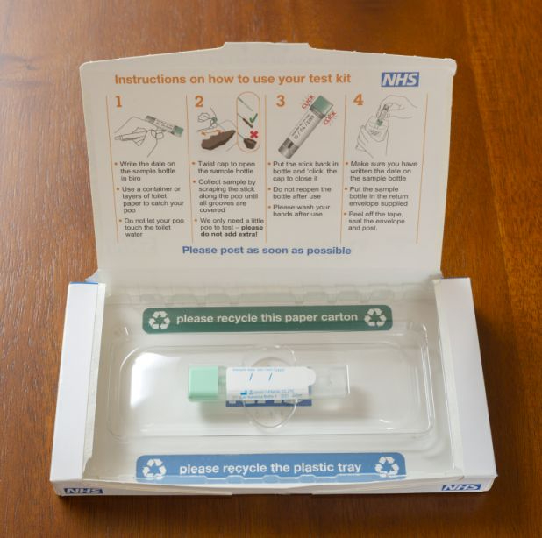
Bowel screening programme
FIT kit
Every 2 years through the post
Send a small poo sample for testing
Do it at home
Easy to use
For people aged 50-74
75 or over can request a kit from the bowel cancer screening programme – call 0800 707 6060
Image credit: NHS Mid Cheshire Hospitals - Cheshire Bowel Cancer Screening Kit

Slide 11
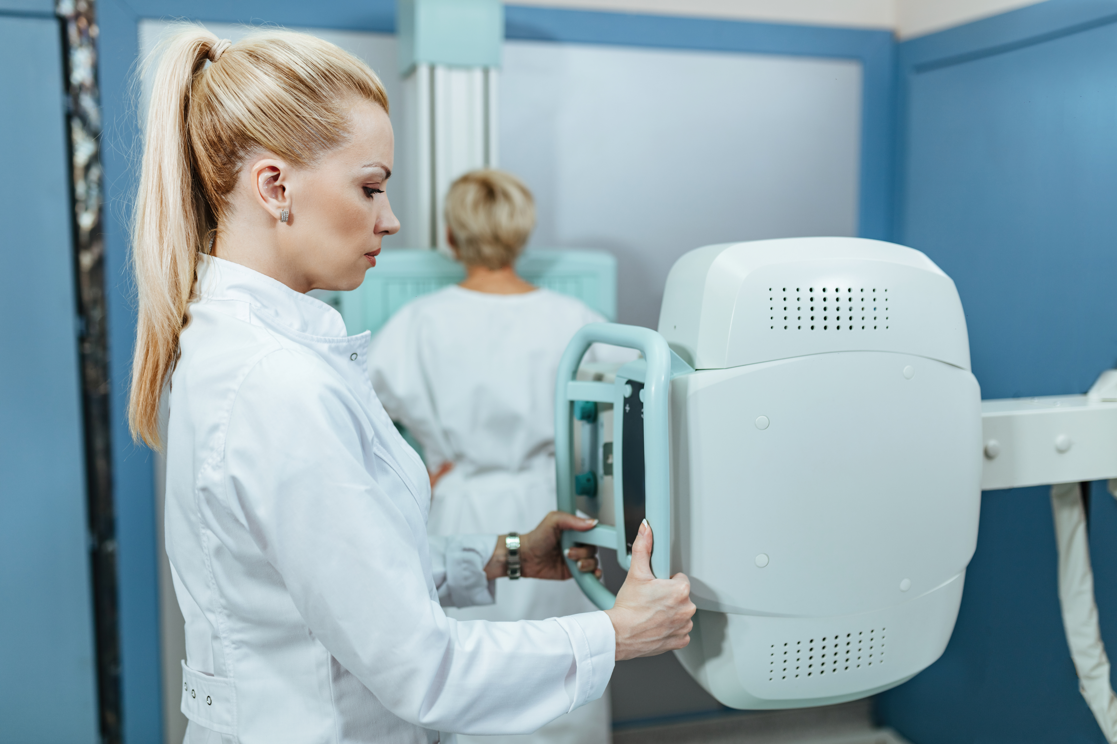
Breast screening programme
Mammogram
Every 3 years
X-ray of the breast
Women / people with breasts
Aged 50 – 70
Over 70 – can still request an invitation via GP or local screening centre
Transgender / non-binary – check with GP or gender identity clinic if you haven’t received an invite and think
you should
Image credit: Drazen Zigic on Freepik; https://www.freepik.com/free-photo/female-doctor-taking-xray-patient-examination-room-hospital_26143922.htm
#from_element=cross_selling__photo

Slide 12
Don’t wait!
Don’t wait for screening – check your breasts/chest each month
Remember it’s not just about lumps and bumps

Slide 13
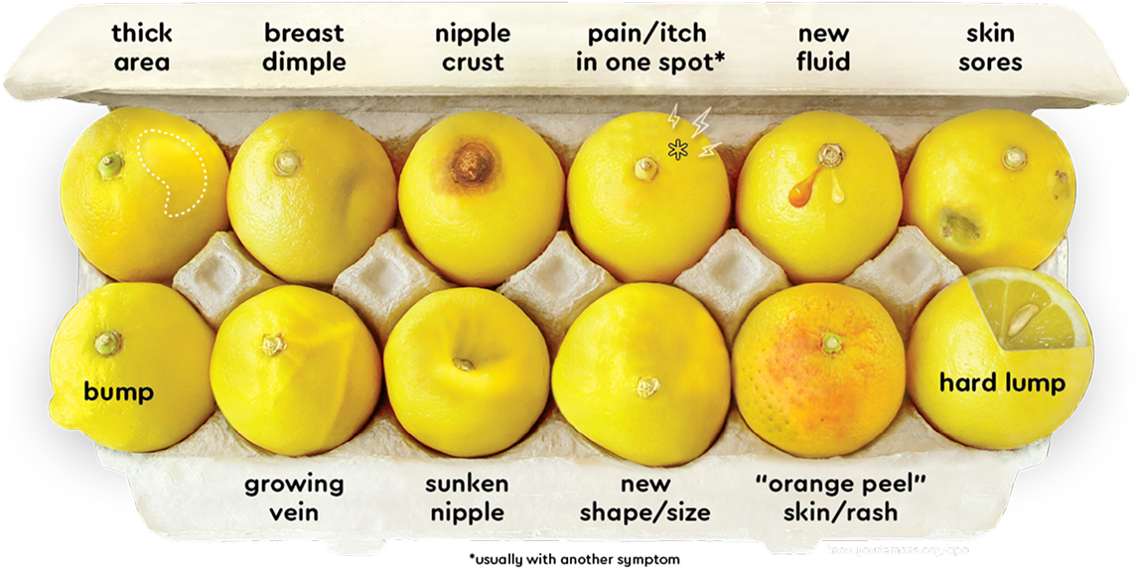
Know your lemons
The signs and symptoms of breast cancer
12 signs of breast cancer to learn about:
knowyourlemons.org

Slide 14
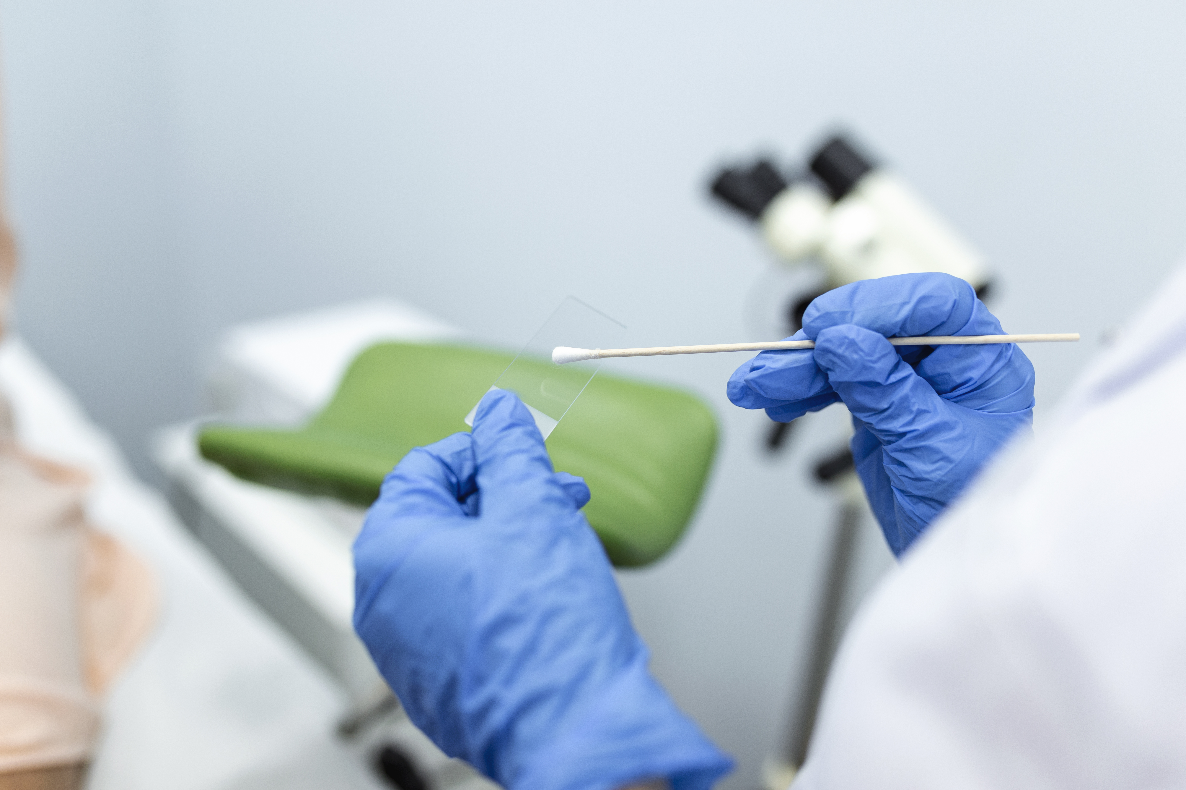
Cervical screening programme
Smear test
Women / people with a cervix
Checks the health of the cervix
Takes a small sample of cells from
the cervix using a brush
Always performed by a female nurse
or doctor
Every 5 years - age 25-64
Not available for over 65’s
Catches cancer early - before symptoms start and can even prevent cancer!
Transgender / non-binary – check with GP or gender identity clinic if you have a cervix but haven’t received an invite
Image credit: Image by stefamerpik on Freepik;
https://www.freepik.com/free-photo/vaginal-smear-closeup-doctor-hand-holds-gynecological-examination-instruments-gynecologist-working-obstetrics-gynecology-clinic_27155402.htm#from View=search&page=1&position=0&uuid=08f77444-f83b-4f29-815b-e72a68d8416d&query=pap+test

Slide 15
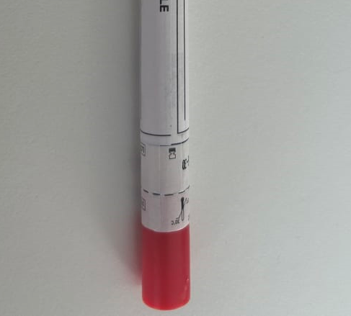
HPV self-sampling kits – new for 2026
Introducing patient HPV sampling kits for home use is part of NHS England’s plan to eliminate cervical cancer by 2040.
Currently, it is estimated that over 5 million women in England are not up-to-date with their routine check-up.
Self-sampling kits may be offered to women and people with cervixes who have rarely or never attended routine screening appointments.
Link to .gov announcement here

Slide 16

HPV vaccine
The HPV vaccine reduces your chances of getting HPV, a virus that causes nearly all cervical cancers.
It is recommended for: -
All children aged 12-13 (school year 8)
Young people aged 24 and under who missed getting vaccinated as a child
Men aged 45 and under who have sex with other men
Other people at higher risk from HPV e.g. people with HIV

Slide 17
National screening programmes
It is estimated that the three national screening programmes save around 10,000 lives each year
A lung cancer screening programme is being developed for anyone
aged 55 – 74 who has smoked. It is expected to be available by 2029.
Link to NHS report here

Slide 18
Prostate cancer – Don’t be the 1
Did you know?
1 in 8 men will get prostate cancer
If you are Black, your risk increases to 1 in 4
Being over 50 or having a family history also increases your risk
of prostate cancer
You can check your risk by visiting Prostate cancer UK website and taking
the risk checker https://prostatecanceruk.org/risk-checker
If you are at high risk, speak to your GP and request a PSA blood test
(You no longer need a finger up your bum to test for prostate cancer!)

Slide 19
Making cancer an everyday conversation
More cancers can be diagnosed early — potentially saving more lives in our community — if we help each other to:
be aware of cancer symptoms and unusual body changes
attend screenings
reduce our risk of cancer (and live better with cancer)
know where to go for information and support

Slide 20
Making cancer an everyday conversation
It’s OK to talk about cancer – if you had a leaking roof and you ignored it,
would it get better?
If you are worried about an unusual symptom and you ignore it,
will it get better on its own?
How much more important is your health than the roof?
Be prepared to talk to a GP and list unusual symptoms
It’s good to talk and to share worries
with your friends, family and colleagues

Slide 21
Making cancer an everyday conversation
Question:
40 years ago, 24% of people diagnosed with cancer survived for at least 10 years. What is that figure now?
30%
40%
50%
60%

Slide 22
Making cancer an everyday conversation
Answer:
C. 50%
Although cancer survival rates have doubled in the last 40 years, we still have a long way to go.

Slide 23
Awareness of unusual and persistent changes
Why is early diagnosis of cancer important?
When a tumour is smaller, and the cancer is in fewer places (i.e. in an earlier stage), treatment is more likely to be successful.
If more cancers were diagnosed in the early stages, 27 lives could be saved each day (10,000 per year).
Booking that GP appointment could be crucial!

Slide 24
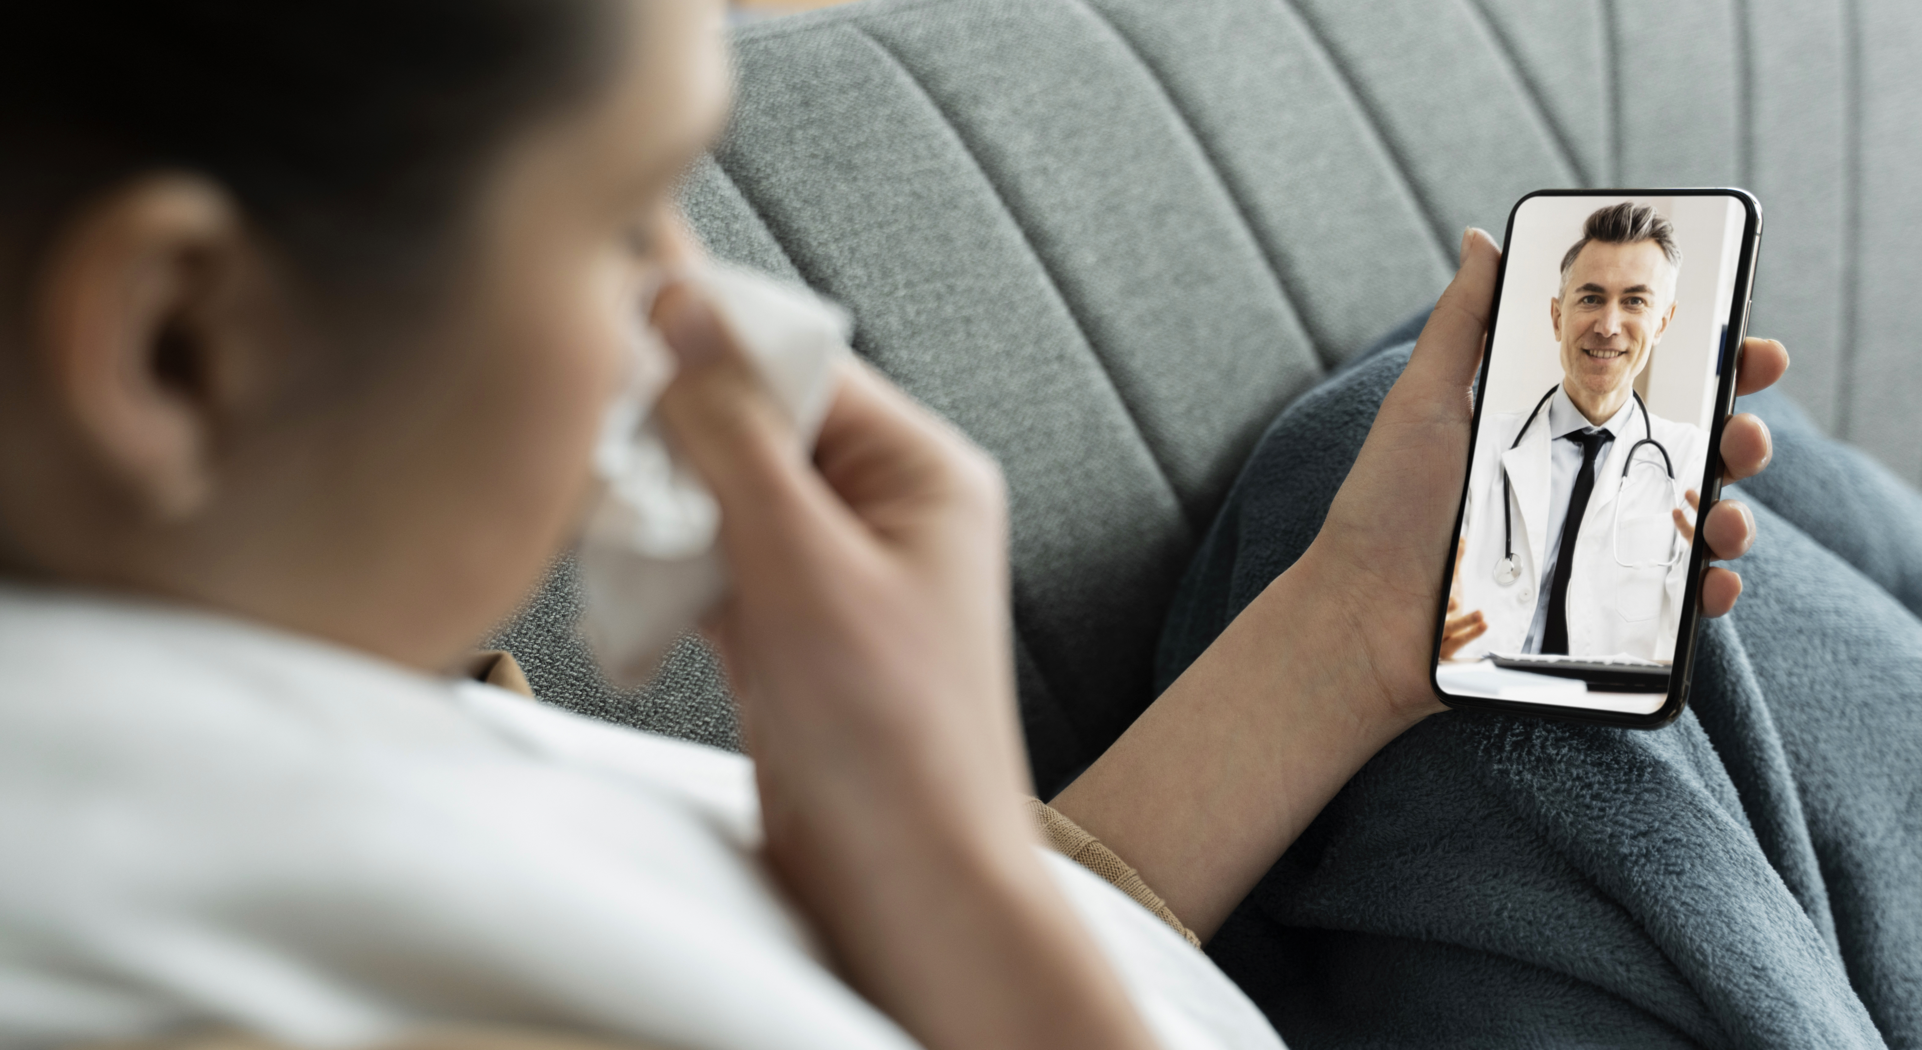
Awareness of unusual and persistent changes
What are the symptoms of cancer?
Unexplained weight loss, fever, unexplained vaginal bleeding, blood in your poo, heavy ‘drenching’ sweats at night, hoarse voice, persistent heartburn/indigestion, mouth/tongue ulcer that won’t heal, unexplained vomiting, change in appearance of eye, breathlessness, change in a mole, persistent bloating, swallowing difficulty, periods become erratic, skin turning yellow, appetite loss, coughing up blood, pain after eating, pale and smelly poo, sore that won’t heal, change in bowel habit e.g. constipation or looser poo, extreme tiredness, persistent tummy pain, breast changes, finding a lump, blood in your wee, difficulties weeing, persistent cough, new mole, unexplained pain or ache, persistent headaches, behaviour change, fits/seizures, testicular changes...
Image credit: Freepik
https://www.freepik.com/free-photo/medical-teleconsultation-sick-patient-home_23988224
.htm#fromView=search&page=1&position=17&uuid=a3cdd25c-ebc4-4044-81f4-9669a22391e6
&query=doctor+virtual

Slide 25
Awareness of unusual and persistent changes
What are the symptoms of cancer?
Unexplained weight loss, fever, unexplained vaginal bleeding, blood in your poo, heavy ‘drenching’ sweats at night, hoarse voice, persistent heartburn/indigestion, mouth/tongue ulcer that won’t heal, unexplained vomiting, change in appearance of eye, breathlessness, change in a mole, persistent bloating, swallowing difficulty, periods become erratic, skin turning yellow, appetite loss, coughing up blood, pain after eating, pale and smelly poo, sore that won’t heal, change in bowel habit e.g. constipation or looser poo, extreme tiredness, persistent tummy pain, breast changes, finding a lump, blood in your wee, difficulties weeing, persistent cough, new mole, unexplained pain or ache, persistent headaches, behaviour change, fits/seizures, testicular changes...
Persistent, unexplained, unusual for you…
Contact your GP!
Image credit: Freepik
https://www.freepik.com/free-photo/medical-teleconsultation-sick-patient-home_23988224
.htm#fromView=search&page=1&position=17&uuid=a3cdd25c-ebc4-4044-81f4-9669a22391e6
&query=doctor+virtual

Slide 26
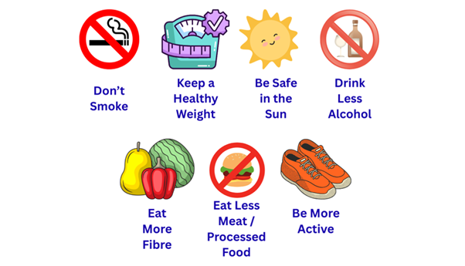
Reduce risk with a healthy active lifestyle

Slide 27
Reduce risk with a healthy active lifestyle
Stop smoking
Smoking causes 15 types of cancer and is the biggest cause of cancer
in the world.
It currently costs around £60,000 to smoke 20 cigarettes a day for 10 years.
Help is available if you want to stop smoking.
Speak to your GP, pharmacist or health adviser or call the free Smokefree National Helpline on 0300 123 1044

Slide 28
Reduce risk with a healthy active lifestyle
Did you know that obesity is the second biggest risk factor associated with cancer after smoking?
Keeping a healthy weight reduces the risk of 13 different cancers.
Body fat signals other cells, telling them what to do. These signals can cause damage and cause cancer to develop.
To get help with losing weight, contact your GP and local weight management services.

Slide 29
Take action NOW against cancer
If you have anything that just doesn’t feel right, it is very important that you speak to your GP as soon as possible.
When caught early, cancer is much easier to treat, with a better outcome.
Cancer won’t go away on its own
So, Take Action Now.

Slide 30
Take action NOW against cancer
Help us spread the word about cancer awareness and potentially save someone’s life
Relatives
Friends
Peers
Colleagues
Anyone in your community and beyond!

Slide 31
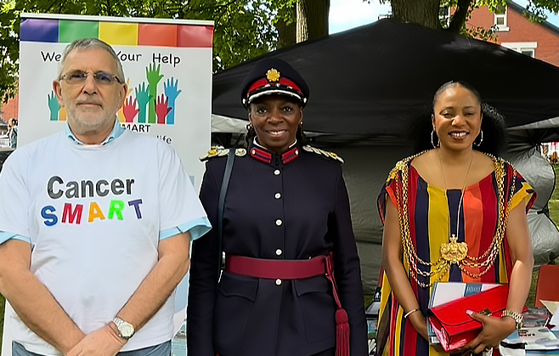
Why not become a Cancer Champion
and help us make cancer an everyday conversation
Contact Jess Hart for more information
jess@yorkshirecancercommunity.co.uk
From Left to Right: YCC Chairman Dr Stewart Manning, Deputy Lieutenant Yvonne Stocks, Former Lord Mayor Cllr Abigail Marshall Katung

