Slide 1
Part 1: Feedback
Part 2: Helping The Helpers
Dr Merry Hill, Consultant Clinical Psychologist
Leeds Teaching Hospitals NHs Trust

Slide 2
Feedback
Part 1: Consultation With Patients And Relatives About Experiences Of Care In West Yorkshire And Harrogate

Slide 3
Outline Aims And Data Collection
To improve the support given to people affected by cancer in our region
Big remit, where are the gaps according to you?
3 patient and relative groups Jan – March 2025
Recorded and analysed the themes

Slide 4
Overall Themes
Psychosocial Care
Communication Skills
Diagnosis
Space to talk
Joined-Up Care
Helpful support
Respectful
Support
Patient-Centred
Signposting
Carers
Navigating complex systems
Accommodating my needs
Having to fit in with the service
Gaps in support
Variable experiences of support
Very poor care experiences

Slide 5
Communication Skills
Diagnosis
"It will set the tone for the rest of your treatment probably and how much you trust the people who are going to treat you“
“it was like just a day job for him. Yeah, it wasn't serious. There wasn't much sympathy and things they maybe they see…. obviously they see everyday or day in, day out”
"They realise just what you do need to decompress a little bit because you might have been quite worried about something. the difference from being treated with sensitivity to being almost dismissed was enormous"
"I couldn't get to an end of a sentence without him interrupting me and telling me what I was feeling“
“they ignore you and they talk like rude to you, you don't feel good”
Space to talk
Respectful

Slide 6
Joined-Up Care
Signposting
"I didn't even know any mental or psychological help was available"
"Recognition from GP that being the relative of someone with cancer isn’t easy“
“But just make people aware that they can get care and help right at the beginning of their journey for their relative”
"if the cancer isn't going to kill me, then the NHS will“
“Nobody really ever checked up. You have to be proactive oneself to make things happen.”
Carers
Navigating complex systems

Slide 7
Patient-centred Care
Accommodating my needs
"Well, it was more than communication because I knew every one of them personally enough“
"So although support was there for her. It wasn't there often when she needed it most"
“I feel I've been suffering with the, you know racism, badly. Was in my room. There was two white ladies and I complained. But they didn't change my bed. No change my room.”
“they were standing outside the window like and talking all night and they didn't come in, you know, I was really in pain. I've been crying. I said please if I can’t move my hand, [ ] They didn't even come and check me.”
Having to fit in with the service
Very poor care experiences

Slide 8
Support
Helpful support
“Problems and everything, when I whatever I was feeling that time. Yeah. So it's really helpful for me. Yeah. And it made a difference.”
“She's the best thing to happen to me when I just feel like she really looks after me.”
“you feel like, yeah, they feel your pain”
"I think I couldn't fault them in any way. They were always a phone call away. If you couldn't speak to somebody directly, they'd phone back within quite a few minutes"
"Now I'm cancer free. That support isn't there. But I don't feel like I'm being cared for by anybody right now."
"actually being asked the deeper questions somebody just not accepting your first answer from a mental psychological well-being"
Gaps in support
Variable experiences of support

Slide 9

What The Health Professionals Told Us
Services need to be better joined up and clearer
Gaps where there are no services need to be filled with skilled specialists
Staff across the system need to be trained to communicate well and assess and signpost
Waiting times are too long, specialist support isn’t timely

Slide 10
Helping The Helpers
Part 2

Slide 11
Aims – please put in the chat what you want help with
How cancer impacts emotionally
What helps?
Listening and responding to concerns
Looking after yourselves

Slide 12
How Cancer Impacts Emotionally
Physical – coping with pain, fatigue, side effects.
Thoughts and feelings – loss and grief, anger and fear, anxiety, issues around survivorship, trauma, treatment decisions
Identity – family role, career, sexuality, spirituality, body image, self-esteem
Threats and losses
  sense of safety and security
  eg. Finance, social contact, certainty, body, health, life, ability/disability

Slide 13
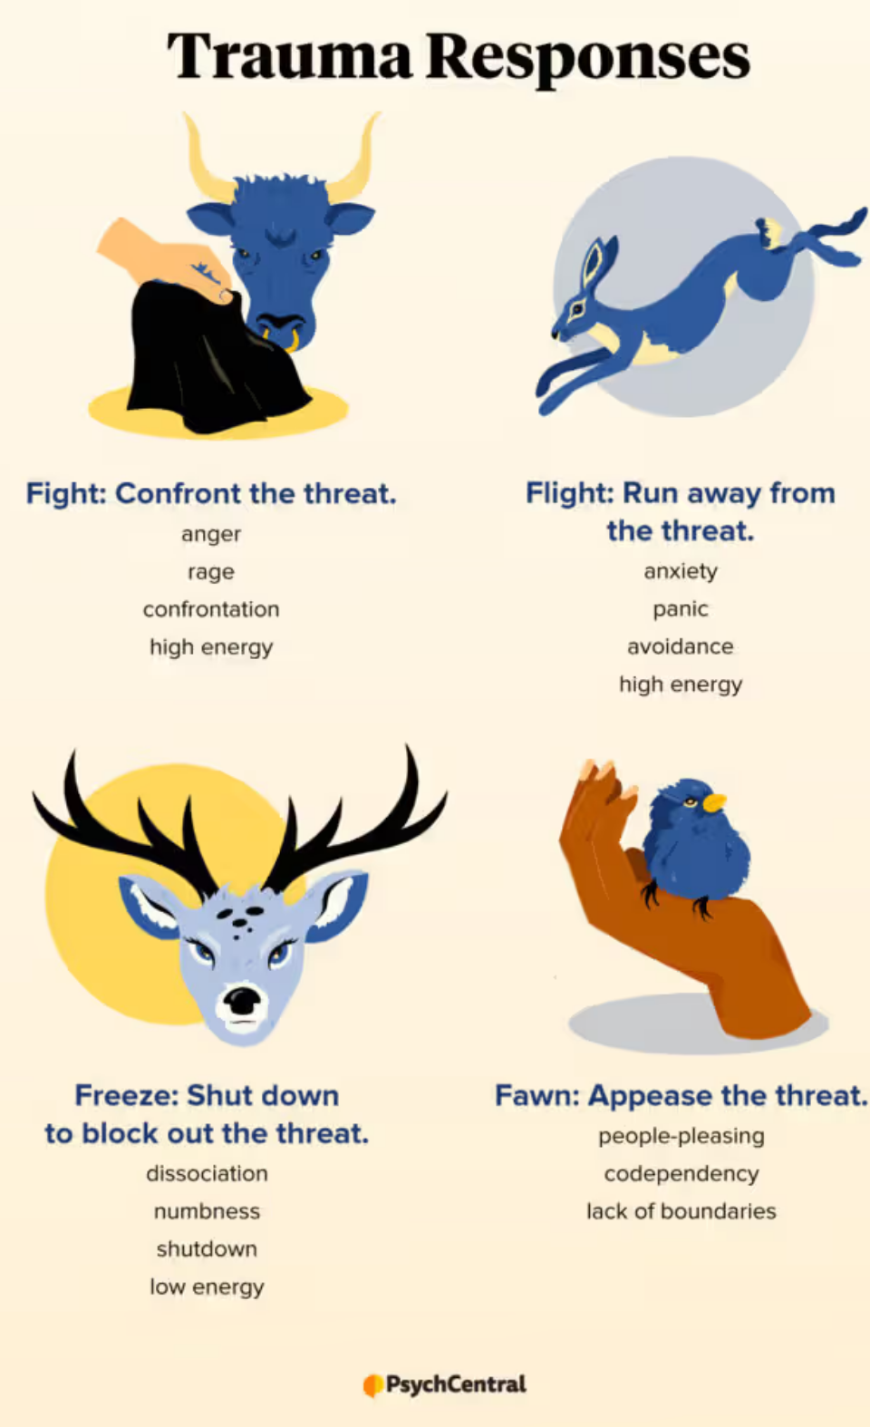
Signs of anxiety
Acute
  Feelings of panic or fear
  Restlessness or rushing
  Excessive worry
  Avoidance
  Sleep
  Concentration
  Irritability or short-tempered
Chronic
  Tiredness
  Longer term impact of avoidance
  Difficulties processing and remembering information
  Social impact
Notes:
Response to perceived threat – to escape the threat or do something to remove the threat
Difficult when it’s a response to non-immediate or imagined threat and impacts on day to day functioning
Serenity prayer

Slide 14

Low Mood And Depression
Feeling low, guilty, hopeless and helpless
Appetite impact
Sleep
Loss of interest, enjoyment and motivation and energy
Loss of concentration
More pain and fatigue
Chronic impact of cycle of negative thinking

Slide 15
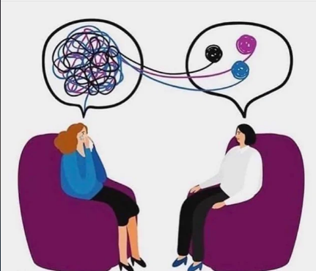
What Helps?
Talking
  Make sense of jumbled emotions and thoughts
  Saying things “out loud”
  Validating emotions – not just crazy
Evidence for this, we lay down new meanings and the emotional expression facilitates problem solving
We underestimate how helpful this is all the time

Slide 16
Listening And Responding To Concerns
Techniques
Examples
Start general and open-ended
Show you are listening
Express empathy
Focus your attention on them fully
How are you? How have you been?
Going through something like this can often be tough, how are you managing?
Is there anything on your mind at the moment? Is there anything you would like to talk through?
Eye contact, Open body language
Continuation sounds like mm, yes
Taking your time – saying how much time you have
Reflecting back “ you say your family has been upsetting you…”

Slide 17

Common Pitfalls
Waiting to speak rather than listening
Making assumptions about how the person is feeling
Jumping in - providing reassurance or advice too soon
Distancing
  It’ll be OK, everyone feels like that, only attending to some of the information
  Not giving the person space to be upset
Trying to fix – just listening and facilitating emotional expression can be enough – hold back
Judging people’s reactions, “it doesn’t seem normal”, aim to be non-judgemental

Slide 18
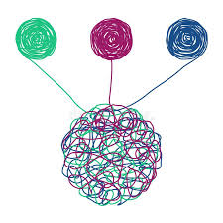
Gather In And Summarise
Keep gathering concerns
Summarise what you have heard
Express empathy
Identify any solutions
Agree a plan with them to end the conversation
“What else is bothering you?”
“that sounds hard” not “ I know what you mean”
Who do you have to support you?
How do they help?
What do you think might help?
Is there anything I can do to help?

Slide 19

Recognising When Specialist Help Might Be Useful
Worry, fear, anxiety and low mood are ‘normal’ reactions.
Can lead to emotional and behavioural changes
If these continue and become chronic, here more help may be required. Or, if they are so extreme that normal day to day life is affected.
Often people themselves are the best judge of when they need extra help but there is stigma..

Slide 20
Identifying Patients Who May Need Additional Support
Around 10% may need specialist support
  Reaction is excessive or unusual or has continued for longer than expected
  Difficulty coping with treatment
  Risk of harm to self or others
  Poor quality of life
  Fears around death or dying
  Difficulties with relationships or intimate relationships
  Problems with substance misuse

Slide 21
Helping People To Get Help
Encourage people to talk to their healthcare teams about how they are feeling
Reassure that its OK to have an emotional reaction and to seek help
Sources of support
CNSs
  Maggies, Cancer Support Centres
  Talking Therapies
  Specialist Psychological Therapy

Slide 22

How To Look After Yourself
“The expectation that we can be immersed in suffering and loss daily and not be touched by it is as unrealistic as expecting to be able to walk through water without getting wet” (Remen, 1996)
What might be particularly difficult for you?
reminders of own experiences, bringing it all back
Not being sure how much to share and how much to get involved
Longer term impact of cancer stories – seeing cancer everywhere, becoming more worried about cancer yourself
How you might be impacted
  Overwhelm and exhaustion,
  Feeling helpless or overly negative
  Feeling disconnected

Slide 23
How To Take Care Of Yourself
Taking care of your body with proper diet, exercise, sleep and rest
Activities that fill you up
  what you find rewarding and soothing and aim for regularity and a balance
Changing working patterns
Support with work eg. regular debriefing process, work life boundaries, recognising your limits
Learn how to tune in to your needs
  Feet on floor, palm to chest
  Make this a habit

Slide 24
Questions?

